Slide 1
Gauss’ Law
Key contents
Electric flux
Gauss’ law and Coulomb’s law
Applications of Gauss’ law

Slide 2
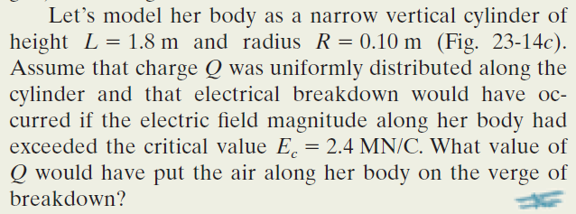
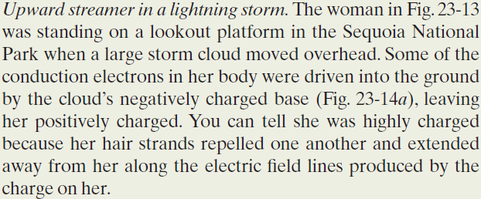
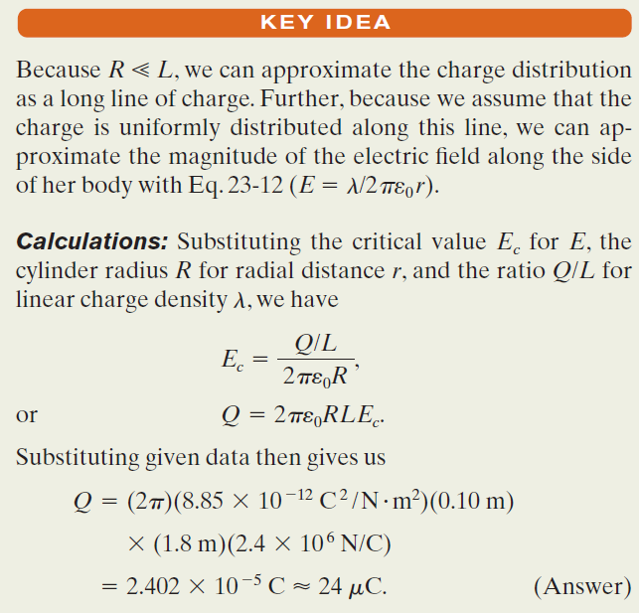
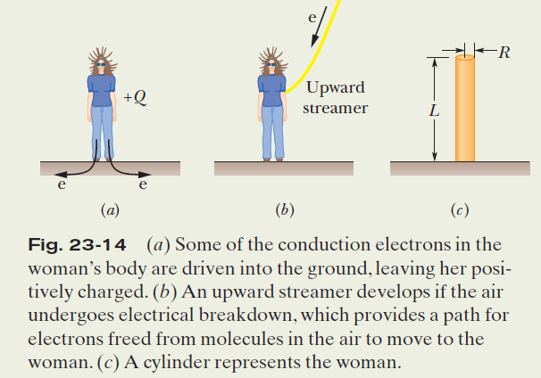
Example, Gauss’ Law and an
upward streamer in a lightning storm:

Slide 3
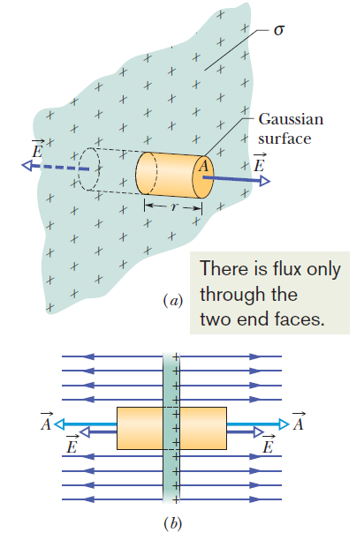
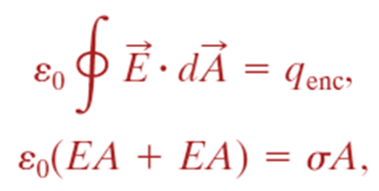
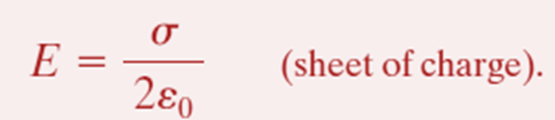
Applying Gauss’ Law, Planar Symmetry
Non-conducting Sheet:

Slide 4
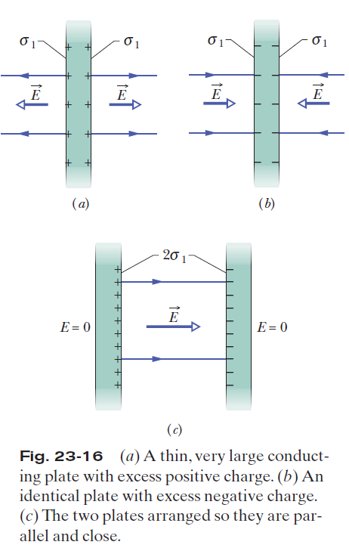
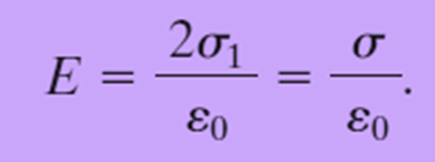
23.8 Applying Gauss’ Law, Planar Symmetry
Two Conducting Plates:

Slide 5
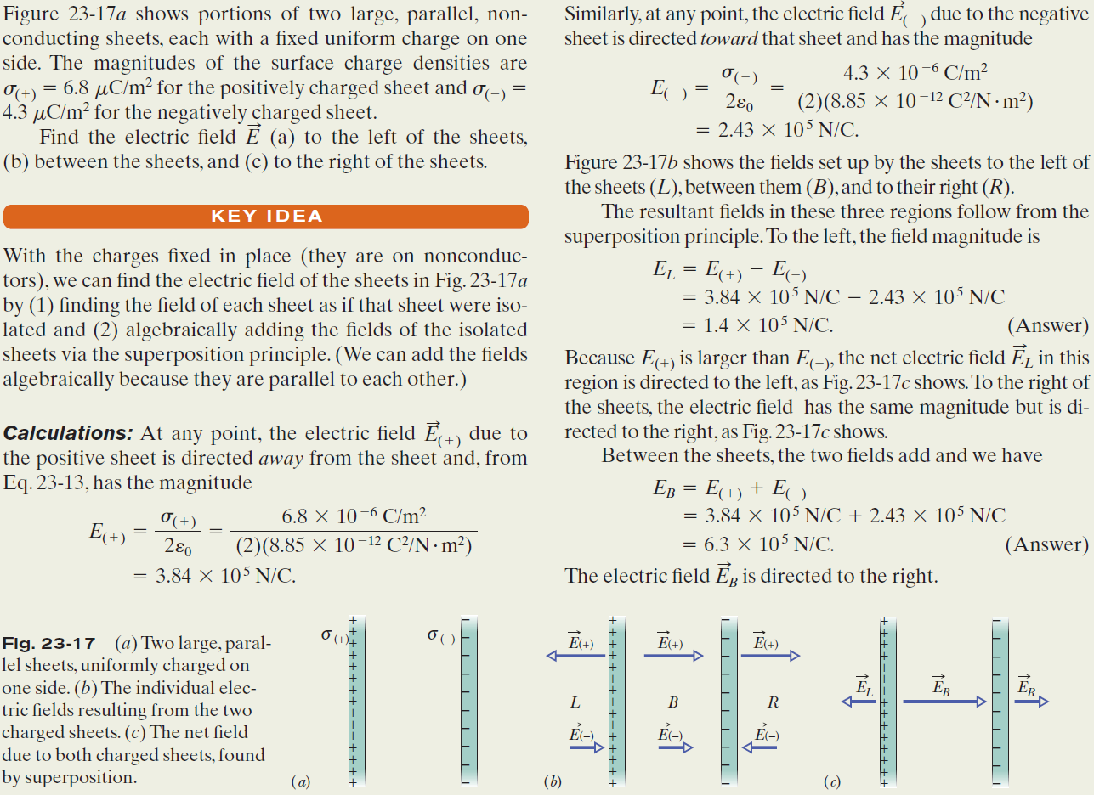
Example, Electric Field:

Slide 6
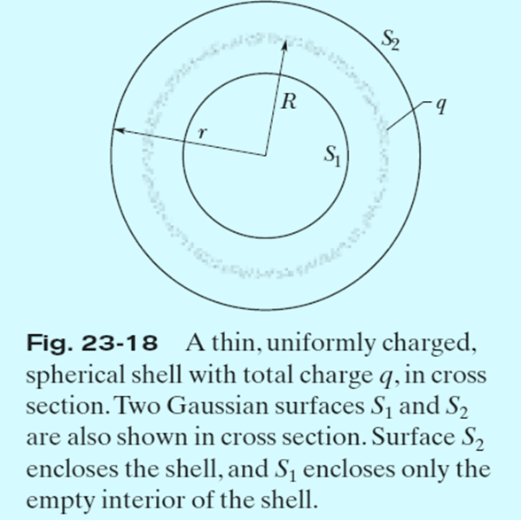
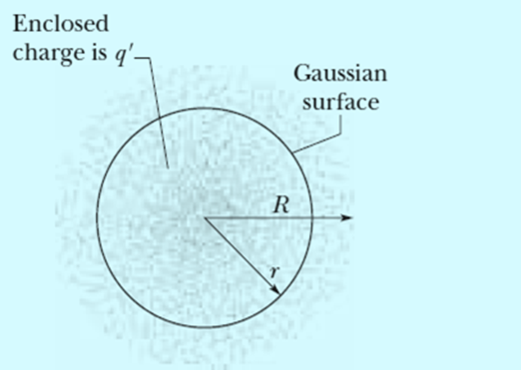




23.9 Applying Gauss’ Law, Spherical Symmetry:
Fig. 23-19 The dots represent a spherically symmetric distribution of charge of radius R, whose volume charge density ρ is a function only of distance from the center. The charged object is not a conductor, and therefore the charge is assumed to be fixed in position. A concentric spherical Gaussian surface with r >R is shown.
# Recall the case for gravitation.

Slide 7
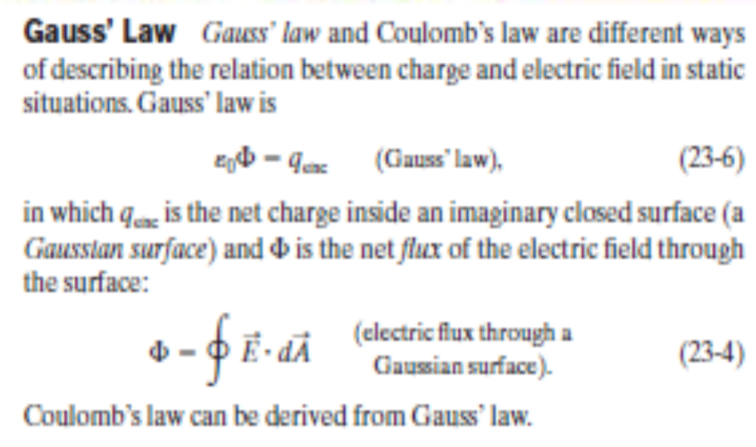


Slide 8
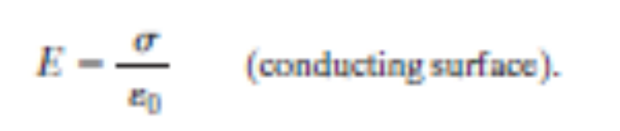
Applications of Gauss’ Law
Using Gauss’ law and, in some cases, symmetry arguments, we can derive several important results in electrostatic situations. Among these are:
An excess charge on an isolated conductor is located entirely on the outer surface of the conductor.
The external electric field near the surface of a charged conductor is perpendicular to the surface and has magnitude
Within the conductor, E=0.

Slide 9
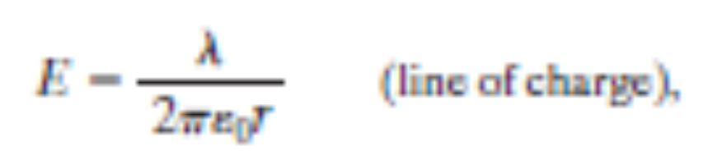
The electric field at any point due to an infinite line of charge with uniform linear charge density l is perpendicular to the line of charge and has magnitude
where r is the perpendicular distance from the line of charge to the point.

Slide 10
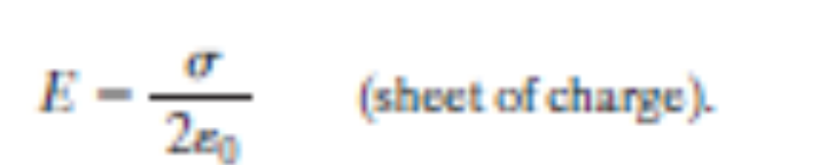
The electric field due to an infinite non-conducting sheet with uniform surface charge density s is perpendicular to the plane of the sheet and has magnitude

Slide 11
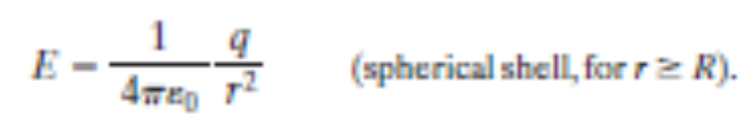
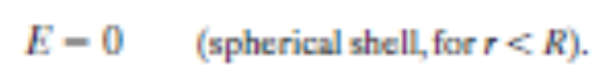
The electric field outside a spherical shell of charge with radius R and total charge q is directed radially and has magnitude
Here r is the distance from the center of the shell to the point at which E is measured. (The charge behaves, for external points, as if it were all located at the center of the sphere.) The field inside a uniform spherical shell of charge is exactly zero:

Slide 12
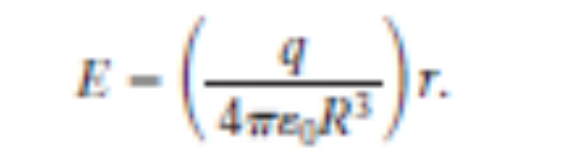
The electric field inside a uniform sphere of charge is directed radially and has magnitude

Slide 13
